Slide 1
Get Hooked
Kevin Gonzalez

Slide 2


Slide 3


Slide 4
So… what are hooks?
New React API
Aimed at reusability
Less boilerplate
Clean code

Slide 5
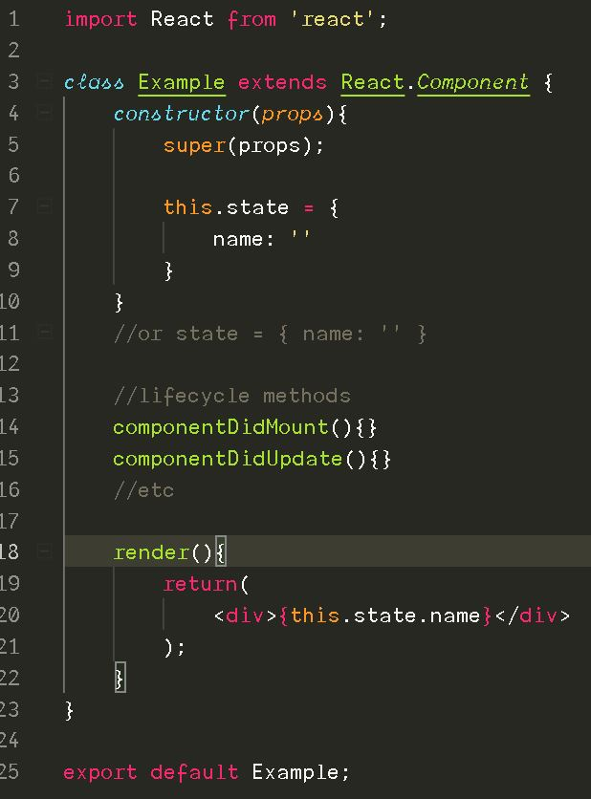

Slide 6
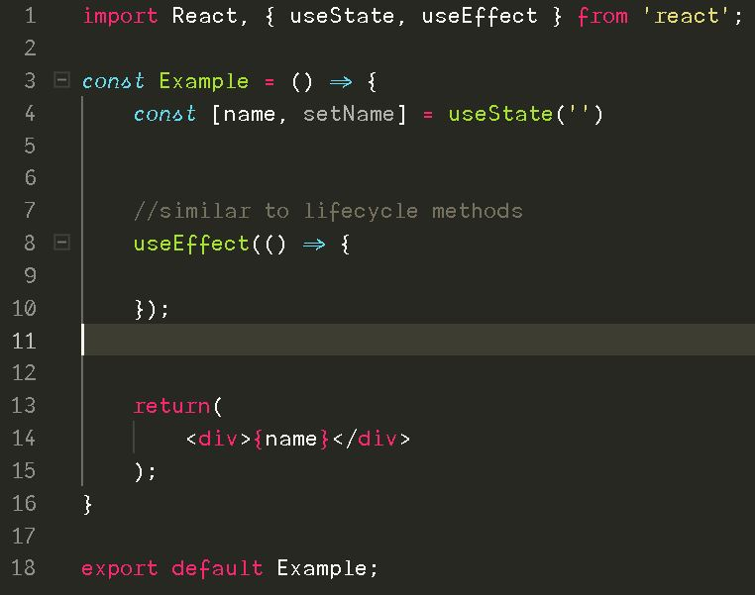

Slide 7
Where are the lifecycle methods in hooks?

Slide 8
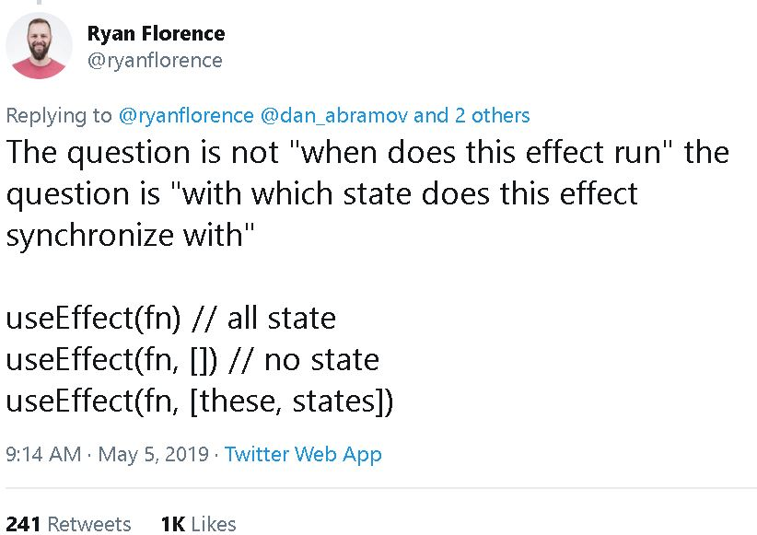

Slide 9
React hooks === functions???

Slide 10
Class based components
Stateful class components
Dumb components – no state, like regular functions

Slide 11
“Crucially, Hooks work side-by-side with existing code so you can adopt them gradually.” – Reactjs team

Slide 12


Slide 13
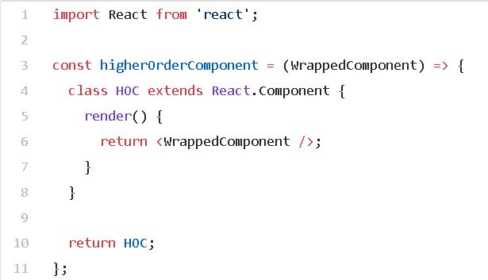
It’s hard to reuse stateful logic between components
Render Props & Higher Order Components – reusable behavior between components
A HOC function takes a component as an argument and returns a component

Slide 14
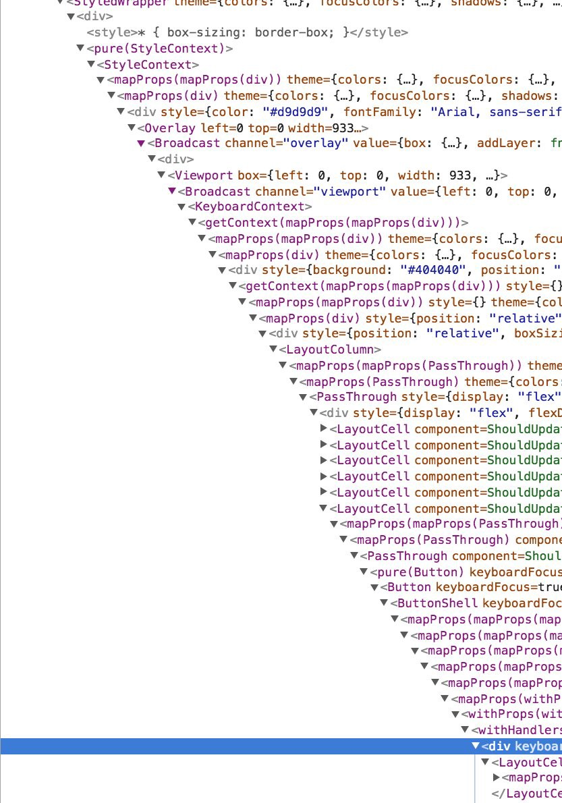
<- Wrapper Hell
Hooks allow you to reuse stateful logic without changing your component hierarchy.

Slide 15
Complex components become hard to understand
“components might perform some data fetching in componentDidMount and componentDidUpdate. However, the same componentDidMount method might also contain some unrelated logic that sets up event listeners, with cleanup performed in componentWillUnmount.”
Hooks let you split one component into smaller functions based on what pieces are related (such as setting up a subscription or fetching data), rather than forcing a split based on lifecycle methods.

Slide 16
Classes confuse both people and machines
“You have to understand how this works in JavaScript, which is very different from how it works in most languages. You have to remember to bind the event handlers.”
“…. we found that class components can encourage unintentional patterns that make these optimizations fall back to a slower path”
Hooks let you use more of React’s features without classes.

Slide 17
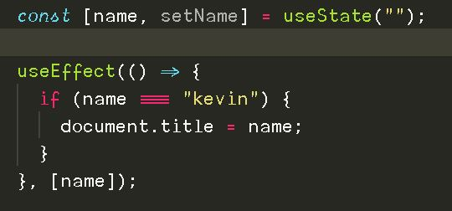
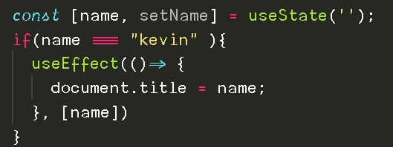
React hooks: Rules..
No loops
No conditions
Custom hooks should start with “use”

Slide 18
Demo time

